Slide 1
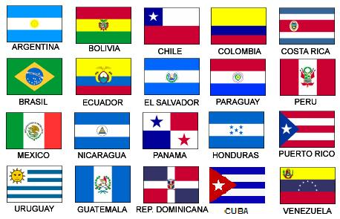
Español IV con Senor Bly
rbly@hazelwoodschools.org
Voicemail 314.502.9209
Class Code: gymotfx
¡Bienvenidos! Continuamos su educación española. ¡No tengan miedo!

Slide 2
Español IV
A skill based class focusing on communication
After reviewing some Spanish I/II/III concepts, you will be introduced to these skills (for example, telling someone what to do) thru videos, vocab lists and verb charts posted on Google Classroom and live, active discussions in
We will practice these skills during our class period thru partner activities, games, Quizlet.com, Kahoot, plus reading, listening and speaking activities.
You are expected to demonstrate these skills during discussions and interviews, Flip Grids, Google Slides, frequent formative assessments on Google Forms
Learning a language is a skill attainable by everyone. In order to improve speaking, just let it flow. Do not worry about mistakes!

Slide 3
Google Classroom
Class Code:
This is our hub, where you will find most of our info, links to resources, schedules,, assignments, and assessments.
Daily, you will be asked to participate in some practice activities and discussion posts in the Stream.
You will find assignments, assessments and projects in the Classwork tab.

Slide 4
Rules and procedures
Please make sure you are making positive decisions that will help you be successful in class.
Be on time. Attempt each activity or assessment.
Attend class. Bring your materials to class.
Use our target language in class.
Be respectful of yourself, your classmates and staff members.
You will have 4 Hall passes per quarter. Any unused Hall passes will earn you 25 points extra credit EACH. Bathroom/locker/water passes are for a maximum of 5 minutes unless agreed upon by Profe Bly.

Slide 5
Rules and procedures
We will follow the school procedures for tardies, truancy, cell phone use and disruptive behavior. In short… First occurrence, you will be refocused by Profe Bly
Upon second correction, there will be communication with parent or guardian.
Further infractions, will result in communication with grade level office.
Communication with you and your family is important to me. I will share and celebrate your successes, but will also share if you are not attempting To Speak Spanish, not participating in class, or are letting your grade slip below a 70%.

Slide 6
Materiales
Los libros:
Esperanza (el presente)
Fiesta Fatal (el presente, el preterito, el imperfecto)
Robo en la noche (el presente, el preterito, el imperfecto)

Slide 7
Syllabus - Pacing Guide
Repaso 1 Review 1 (8 weeks)
Students will be able to:
Greet and say goodbye to others, introduce themselves and others
Describe their classroom, friends, family and others
Reflexive verbs (action upon oneself, reciprocal action, always reflexive)
Direct, indirect and double object pronouns
Practice writing skills with photo prompts
Speaking assessments
Esperanza (novela)

Slide 8
Repaso 2 el pasado - Review 2 (9-10 weeks)
Students will be able to:
Discuss events that occurred in the past with the preterit
Discuss repeated past actions with the imperfect
Compare and contrast the uses of the preterit and imperfect past tenses
Compare and contrast festivals in Spanish speaking countries with ones familiar to them
Read about LA TOMATINA y LA CORRIDA DE TOROS - Proyecto “Un día festivo”
Fiesta Fatal

